Slide 1

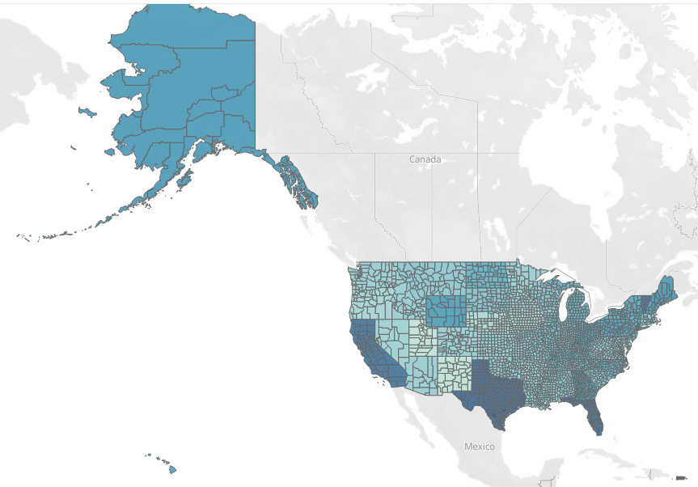
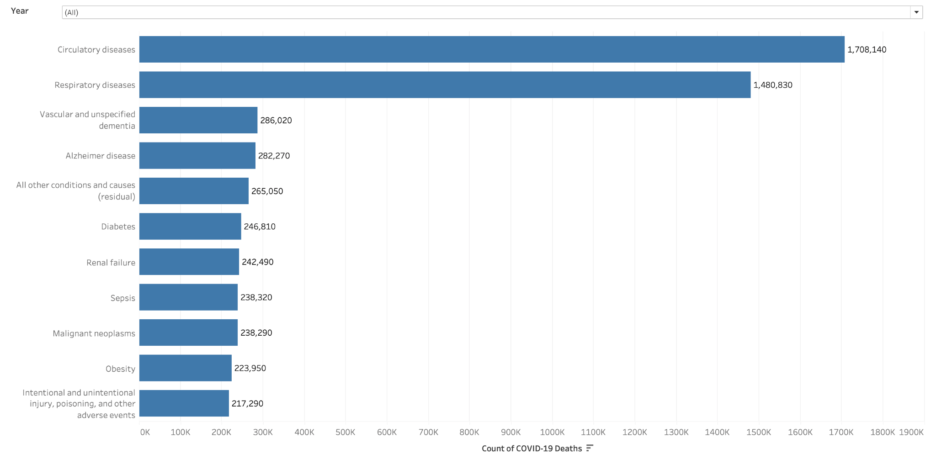
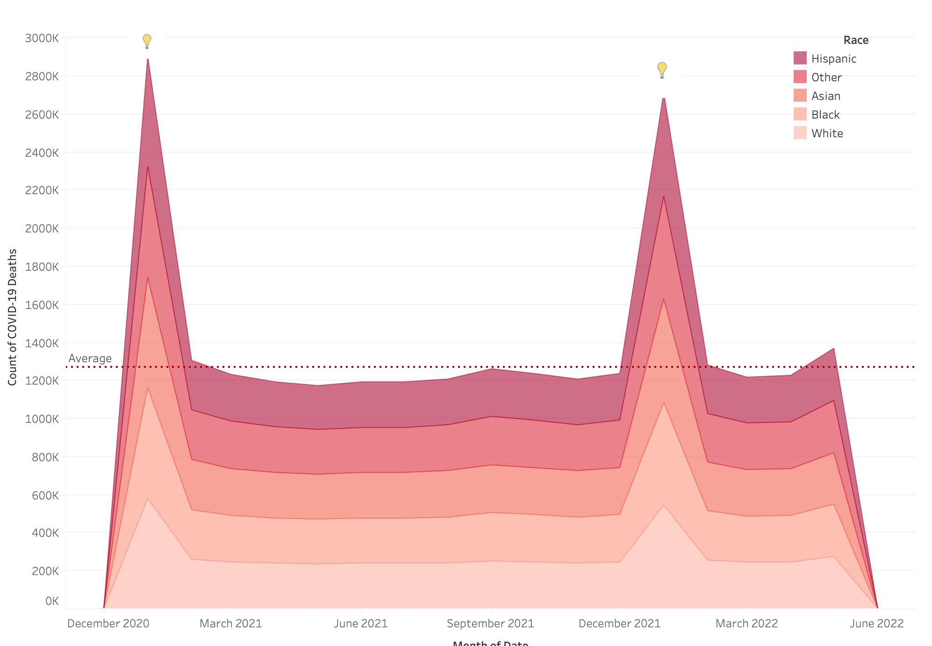
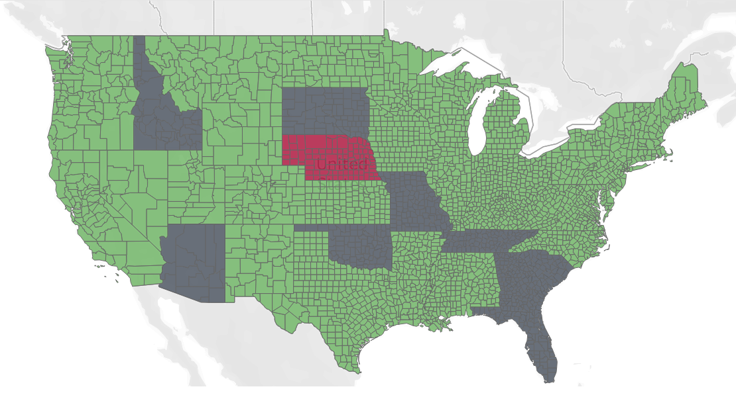
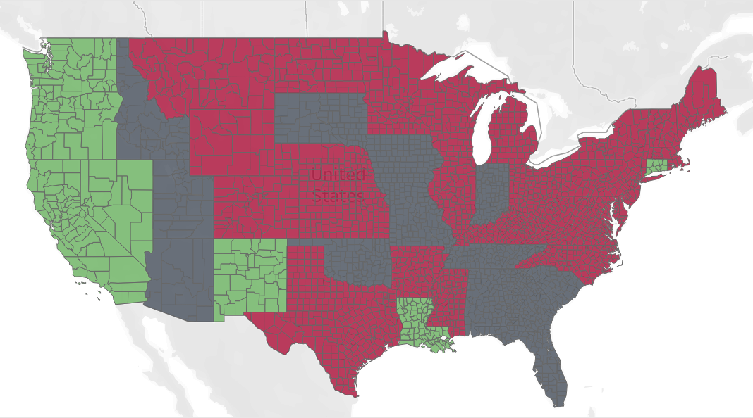
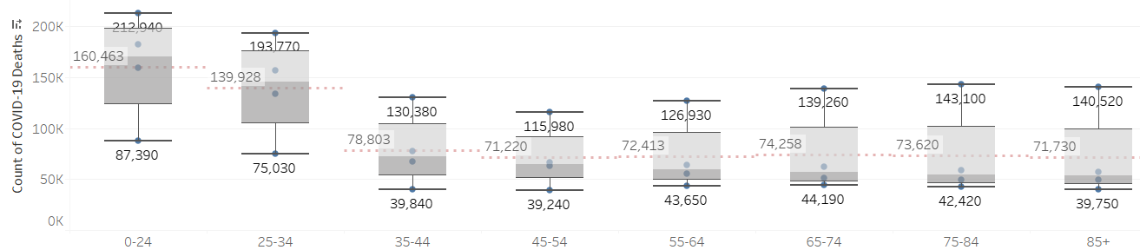
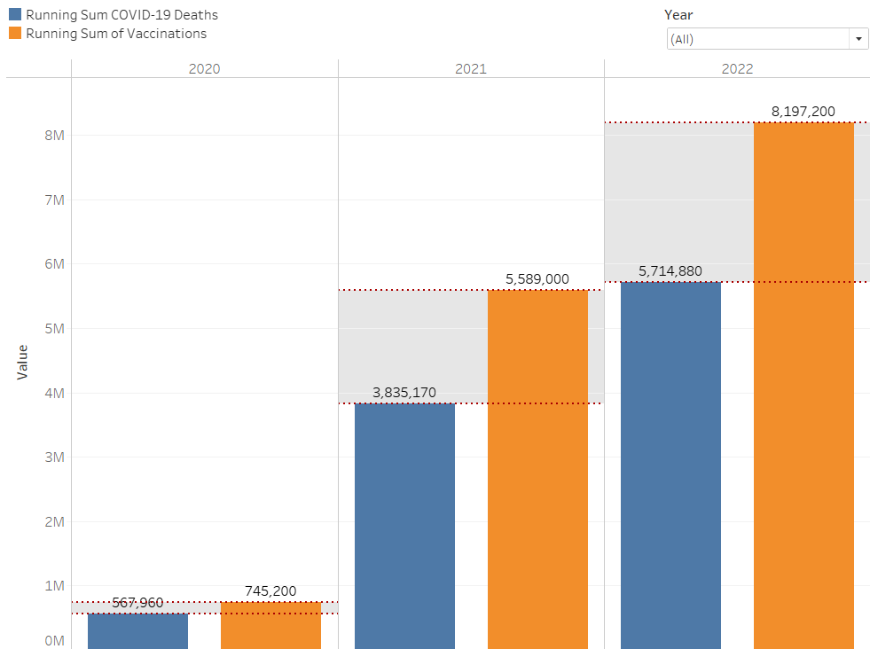
The role of demographics, underlying clinical conditions, and governmental policies during the COVID-19 Pandemic.
[Case study - USA]
Prepared by: David Liu, Oladayo Olatubosun, Maaz Farooqi, Tasfin Noisik,
Instructors: Adiebonye Jumbo, PhD
Medical Informatics Program, College of Health-Related Professions, SUNY Downstate Health Sciences University
The goal of this project is to study big COVID-19 data, analyze and create meaningful visualizations to help unravel the parts played by demographics, underlying clinical conditions and governmental policies.
Introduction
Patients had flu-like symptoms, but asymptomatic people continued to spread the virus through close contacts. As everyday life ground to a halt and federal and state governments became desperate, face masks, social distancing, and remote work became the norm. The CDC and other government agencies want big pharma to develop a vaccine. Vaccines and facemask mandates caused the numbers to plateau despite political unrest and public scorn. The mutated Delta and Omicron microbes caused a noticeable spike despite the vaccine and booster. Variable causes of death prove COVID-19 was deadly.
In this project, the end user Dr. Smith, who is an infectious disease doctor, wants us to detect fatality-prone illnesses. Dr. Smith requested us to focus on mask mandates and vaccination numbers to visually connect the dramatic changes to the national morbidity and mortality rate. This project's attention to datasets [1-3] helped to make sense of the numbers by breaking down the most to least affected ethnic groups. Also under review is how dynamic and unknown public health advocacy was compared to the death toll. The virus seemed to capture life, and the health care community couldn't agree on how to curtail or prevent COVID-19's wide variety of health conditions.
To cover the pandemic's first year, The resources ran out, the staff was sick and dwindling, and it was hard to get life-saving equipment. Trauma centers and regional hospitals were overwhelmed by patients seeking treatment for this rare disease. Before the pandemic, many of them were healthy. Others were susceptible to a fast-spreading illness. Inconsistent symptoms added to clinical uncertainty in patient management. Pre-existing conditions like heart disease and respiratory illness made patients more vulnerable. The public illness affects the central nervous system, digestive system, and circulatory system.
Relationship of COVID-19 Deaths and Face-Mask Mandates by States
Ethnic distribution of COVID-19 Deaths
Underlying morbidity risks
The area chart shows COVID-19 deaths across major ethnic groups. The major ethnic groups were considered for this study while the minor groups were grouped under a category (Other).
Analysis shows that the Hispanic population have the most COVID19 deaths, while the White population have the least.
4/10/2020
US Department of Health and Human Services (HHS), along with NIH and CDC agree with Healthcare professionals that the greatest risk to human body is the virus’ capability to adversely affect heart and lung function at the cellular level [4].
The visual above also agrees the two highest morbidity risks to be CARDIOVASCULAR and RESPIRATORY diseases.
8/15/2021
Age distribution of COVID-19 Deaths
Comparative Running Totals of COVID-19 Deaths vs Vaccinations
A thorough comparative analysis of COVID-19 mortality per county against Government's face-mask mandate shows face-mask wearing in public is not an Effective public health preventive measure.
Analysis 1: Texas and Florida are the states with the highest COVID-19 mortality rates despite face-mask mandates by the State Governments.
Analysis 2: Nebraska is one of the states with the lowest COVID-19 mortality rates despite NO face-mask mandate by the State Government.
Using methods such as a running total, tooltips and manipulations, which can be performed using bar graphs and box and whisker plots, the user can see for themselves what the data suggests. Ever-present are the social determinants of health from state to state. How can elected officials better develop and roll out a strategy to assist with a pandemic in real-time? History provides a vital tool at the expense of citizens' lives, specifically the minority ethnic groups and younger generation.
End users will be able to connect the dots to assimilate the plethora of data which exists for mask mandates in a future contagious disease outbreak by state, decipher which state protocol needs to be renegotiated to minimize citizen mortality, and create a health advocacy strategy which is succinct and easy to implement.
The 0-24 group have the highest COVID-19 deaths with an average of 160,000+, the 25-34 group have the second highest COVID-19 deaths with an average of almost 140,000. However, age groups ranging between 35 and 85+ have nearly the same average, approximately in the 70,000s.
The increment in gap between VACCINATIONS vs COVID-19 DEATHS bins explains an INVERSE RELATIONSHIP: as more citizens get vaccinated, COVID-19 deaths reduced relatively over time.
References
[1] IISInfo. COVID-19 Vaccination Demographics in the United States,National | Data | Centers for Disease Control and Prevention. 2022.https://data.cdc.gov/Vaccinations/COVID-19-Vaccination-Demographics-in-the-United-St/km4m-vcsb (accessed 12 Aug 2022).
[2] Howard-Williams M. U.S. State and Territorial Public Mask Mandates From April 10, 2020 through August 15, 2021 by County by Day | Data | Centers for Disease Control and Prevention. 2021.https://data.cdc.gov/Policy-Surveillance/U-S-State-and-Territorial-Public-Mask-Mandates-Fro/62d6-pm5i (accessed 12 Aug 2022).
[3] NCHS. Conditions Contributing to COVID-19 Deaths, by State and Age, Provisional 2020-2022 | Data | Centers for Disease Control and Prevention. 2022.https://data.cdc.gov/NCHS/Conditions-Contributing-to-COVID-19-Deaths-by-Stat/hk9y-quqm (accessed 12 Aug 2022).
[4] COVID-19 and the Heart | NHLBI, NIH. https://www.nhlbi.nih.gov/coronavirus/heart (accessed 12 Aug 2022).

